Slide 1
Boosting Algorithm-Regression
Boosting Algorithm has 3 Types:
1) Ada Boost Algorithm 2)XG Boost Algorithm
3)LG Boost Algorithm
Ada Boost Algorithm:
An AdaBoost regressor is a meta-estimator
that begins by fitting a regressor on the original dataset and then fits additional copies of the regressor on the same dataset
but where the weights of instances are adjusted according to the error of the current prediction. As such, subsequent regressors focus more on difficult cases..

Slide 2
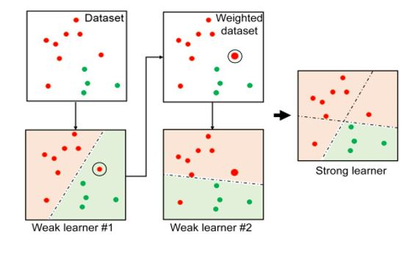
Ada Boost Algorithm

Slide 3
Ada Boost Algorithm
Ada Boost Algorithm also Known as Adaptive Boost Algorithm.
Ada Boosting is a popular ensemble learning technique.
It combines multiple weak learners to create a strong predictive model.
Weak Learners:
AdaBoost starts with a weak learners. Which is a simple model that performs slightly better than random guessing. A common choice is a decision stump, which is a decision tree with a depth one.

Slide 4
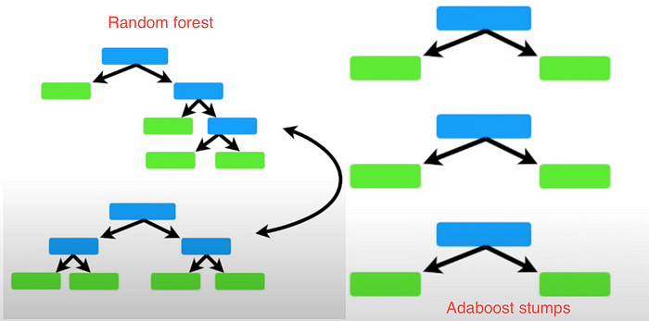
Difference Between Decision Treen and Ada boost

Slide 5

If you see in random forest method, the trees may be bigger from one tree to another but in contrast, the forest of trees made by Ada boost usually has just a node and two leaves. (A tree with one node and two leaves is called a stump)So Ada boost is a forest of stumps. In a random forest, each decision tree is independent of each other(i.e. one tree will not depend on other trees)but in Ada boost each stump depends on the predecessor’s error

